Slide 1





HCDR Final Project
Group Number: 3
Team Name: FP_Group_3
Alicia Aaholm
Nicholas Chappell
Jaden Costa
Katia Torres Sanchez

Slide 2
Outline
Project Description
Phase 3 Summary Visual EDA
Overview of Modeling Pipelines Explored
Conclusion and Next Steps
Results and Discussion of Results

Slide 3
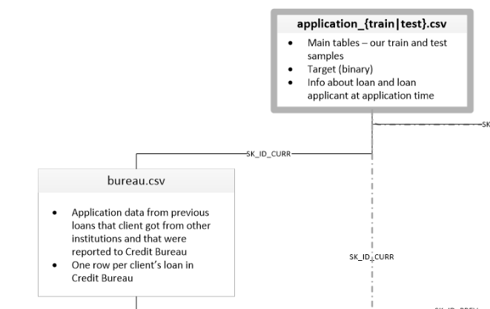
Project Description
The HCDR project model aims to train a model to predict whether a lender would be able to pay off a loan.
During Phase 3, the tasks to be tackled included feature engineering, hyperparameter tuning, feature selection, and ensemble methods.
Data used during this phase were datasets bureau and application_train

Slide 4
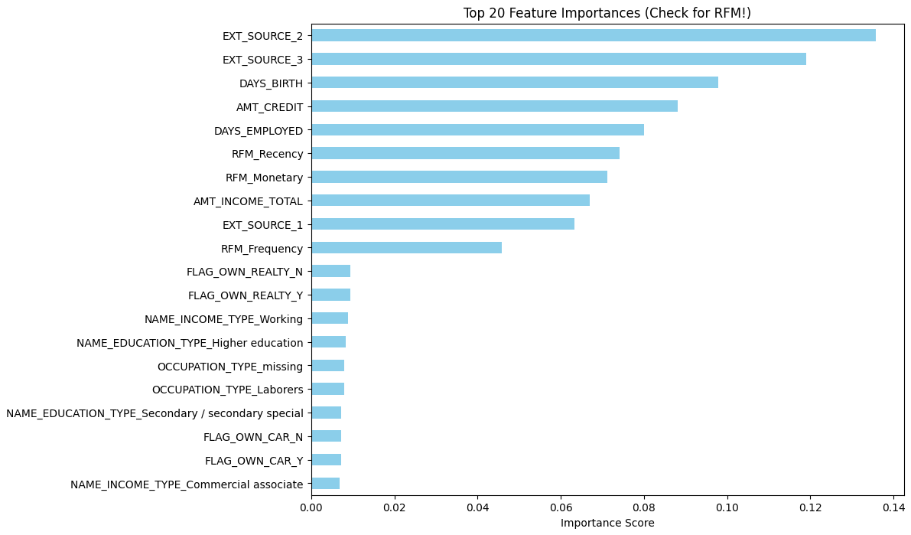
Phase 3 Summary Visual EDA
Phase 3 had feature engineering and hyperparameter tuning performed
Focused on:
Recency: Time since last credit
Frequency: Count of previous loan
Monetary: Total past credit amount
Data lineage: Merged bureau and application_train datasets
Imputed NaN appropriately and created RFM features

Slide 5
Overview of Modeling Pipelines Explored
RFM Feature Engineering: Created Recency, Frequency, and Monetary features from the bureau dataset and merged them into the application data.
Hyperparameter Tuning: Used RandomizedSearchCV to optimize a Random Forest across key parameters with 3-fold CV and ROC AUC scoring.
Ensemble Methods: Combined Logistic Regression and a tuned Random Forest in a soft-voting ensemble, leveraging both linear and tree-based strengths.
Feature Importance: Used the Random Forest’s feature importances to identify top predictors and validate the contribution of engineered RFM features.

Slide 6
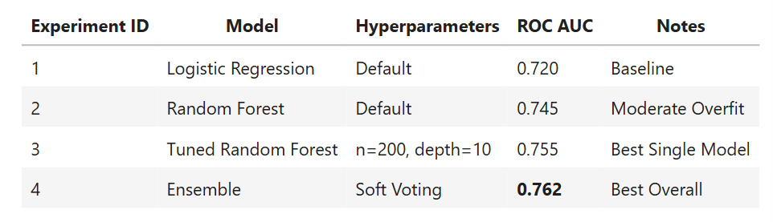
Results and Discussion of Results
RFM features: added ~+0.015 AUC by capturing customer behavior patterns.
Tuned Random Forest (0.755 AUC): best single model after improving stability through tuning.
Soft Voting Ensemble (0.762 AUC): highest overall score by balancing model strengths.
Default Random Forest: showed moderate overfitting before tuning.
Leaderboard gap (0.795): likely requires gradient boosting and richer installment/behavior features.
Experiment Table
Notes:
Explain why you chose the method and approach in presentation/results/discussion sections- FEATURE ENGINEERING
Explain the method you choose and why in presentation and results/discussion- HYPEROARAMETER TUNING

Slide 7
Conclusion and Next Steps
We plan to fine-tune our hyperparameters and ensure our application is ready for Production by Phase 4's due date
We plan to document our results in further detail once we have further trained our model
We'll use these results as a guide for implementing multi-layer perceptrons (MLPs)

